Slide 1

Microprocessor Systems
Lab9 - In System Programming & POV clock
Prof. Ren-Shuo Liu
NTHU EE

Slide 2
Outline
In system programming
POV clock

Slide 3
In System Programming (ISP)

Slide 4
Burner / Programmer
A burner/programmer is a hardware device accompanied with software which is used to transfer the machine language code to the microcontroller/EEPROM from the PC.
The API/software of the burner reads data from the hex file stored on the PC and feeds it into the controller’s memory.
The software transfers the data from the PC to the hardware using serial, parallel or USB port.

Slide 5
In System Programming (ISP)
ISP allows microcontrollers and external memory chips can be re-programmed without being removed from the circuit board.
For in-system programming, the following items are needed
  A software tool running on the PC, which is able to control the programming interface via any standard port.
  A programming adapter which allows to connect the programming interface to any standard port available at the PC, like USB.
  A special programming interface like SPI (Serial Programming Interface).

Slide 6
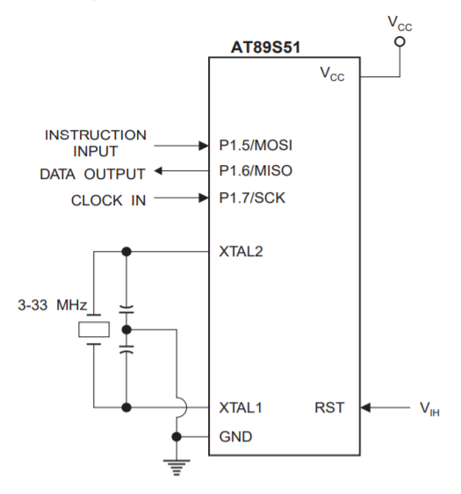
8051 Memory I/O
Vcc: Connected to +5V supply.
GND: Connected to ground.
RST: It tells the target controller that it is under the programming mode.
SCK: This pin is used to supply clock to the target microcontroller.

Slide 7
8051 Memory I/O
MOSI: Master Out Slave In
  This is the input pin of the target microcontroller.
  Every signal including data, address and control are received on this pin of the target microcontroller.
MISO: Master In Slave Out
  This is the output pin of the target microcontroller which sends the acknowledgement signals to the master controller.

Slide 8
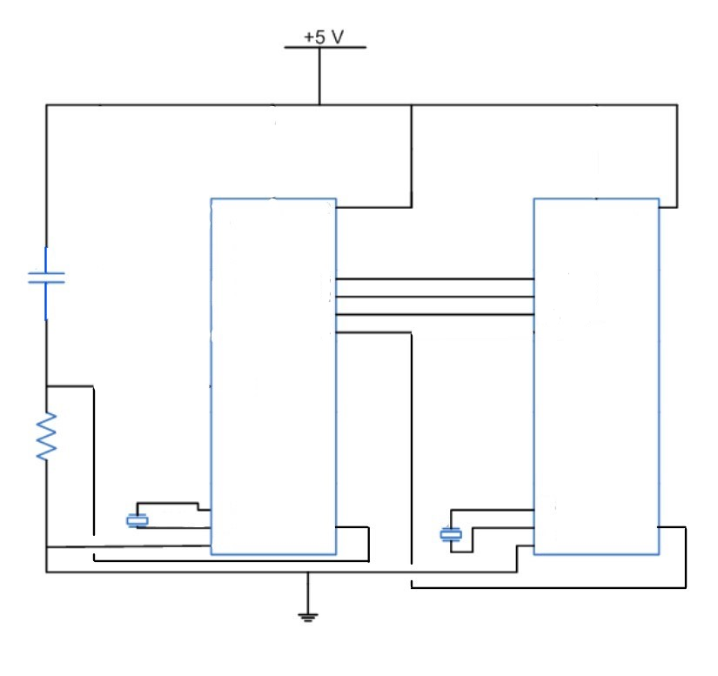
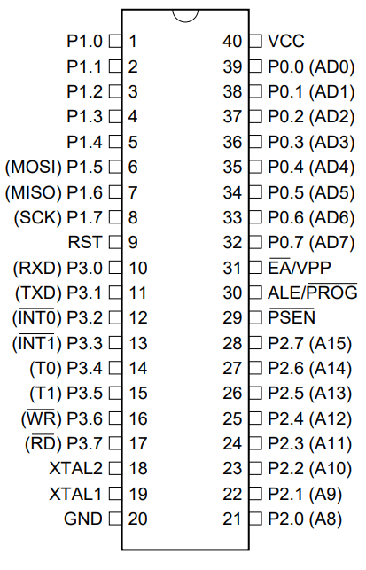
8051 Memory I/O
VCC
VCC
P1.5/MOSI
P1.6/MISO
P1.7/SCK
Master
Slave
AT89S51 I/O
XTAL2
XTAL2
XTAL1
RST
XTAL1
RST
GND
GND

Slide 9
Serial Programming Algorithm
Power-up sequence:
  Apply power between VCC and GND pins.
  Set RST to high.
  If a crystal is not connected across pins XTAL1 and XTAL2, apply a 3 MHz to 33 MHz clock to XTAL1 pin and wait for at least 10 milliseconds.
Enable serial programming:
  Send the Programming Enable serial instruction to pin MOSI/P1.5.
  The frequency of the shift clock supplied at pin SCK/P1.7 needs to be less than the CPU clock at XTAL1 divided by 16.

Slide 10
Serial Programming Algorithm
The Code array is programmed one byte at a time in either the Byte or Page mode.
  The write cycle is self-timed and typically takes less than 0.5 ms at 5V.
Any memory location can be verified by using the Read instruction that returns the content at the selected address at serial output MISO/P1.6.
At the end of a programming session, RST can be set low to commence normal device operation.
Power-off sequence (if needed):
  Set XTAL1 to low (if a crystal is not used).
  Set RST to low.
  Turn VCC power off.

Slide 11
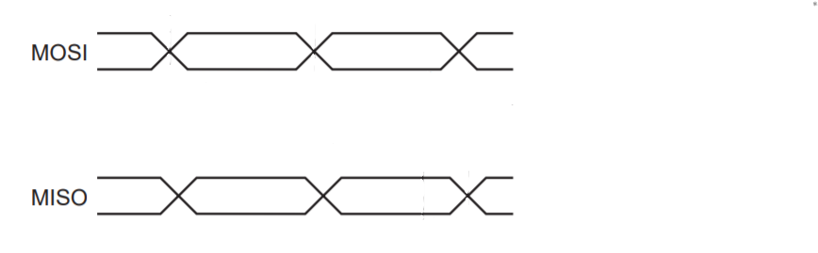
Programming Enable
Instruction | Byte1 | Byte2 | Byte3 | Byte4
Programming Enable | 1010 1100 | 0101 0011 | xxxx xxxx | xxxx xxxx 0110 1001 (Output)
Enable Serial Programming while RST is high
1010 1100
0101 0011
xxxx xxxx
xxxx xxxx
Can check if enable or not
0110 1001

Slide 12
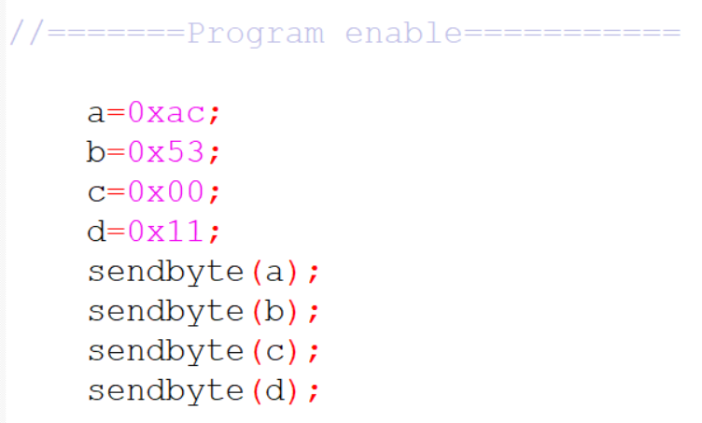
Programming Enable
1010 1100
0101 0011
Don’t Care

Slide 13
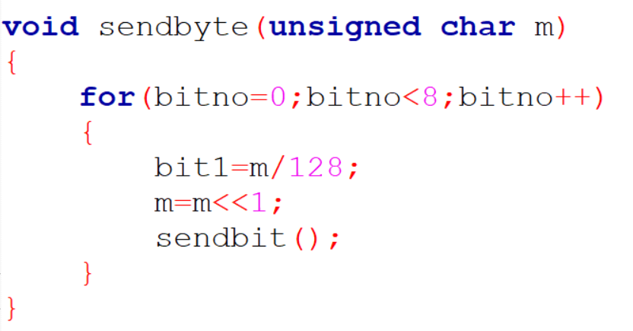
sendbyte()
1 byte = 8 bits
MSB
00110011
00110011
00110011
m<<1
00110011
…

Slide 14
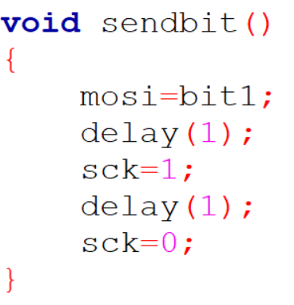
sendbit()

Slide 15
Read Program Memory (Byte)
Instruction | Byte1 | Byte2 | Byte3 | Byte4
Read Memory (Byte Mode) | 0010 0000 | xxxx A[11:8] | A[7:0] | xxxx xxxx D[7:0] (Output)
Read data from Program memory in the byte mode
A[11:0] : 12-bit address , D[7:0] : 8-bit data
0010 0000
xxxx A[11:8]
A[7:0]
xxxx xxxx
D[7:0]

Slide 16
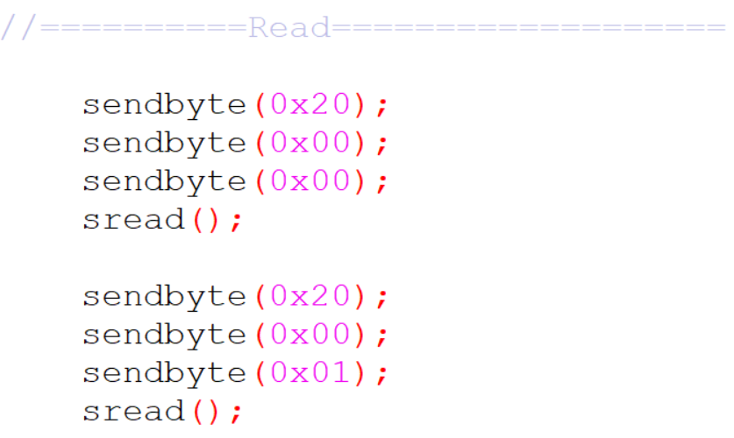
Read Program Memory
0010 0000
xxxx A11A10A9A8
A7A6A5A4A3A2A1A0
Read the data at address 0000 0000 0000
Read the data at address 0000 0000 0001

Slide 17
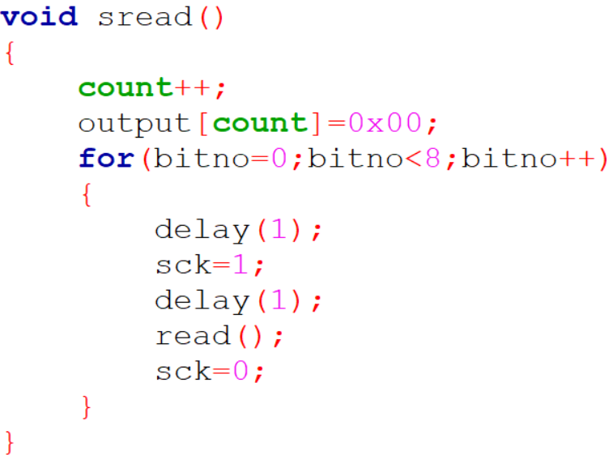
sread()
unsigned char array
1 byte = 8 bits

Slide 18
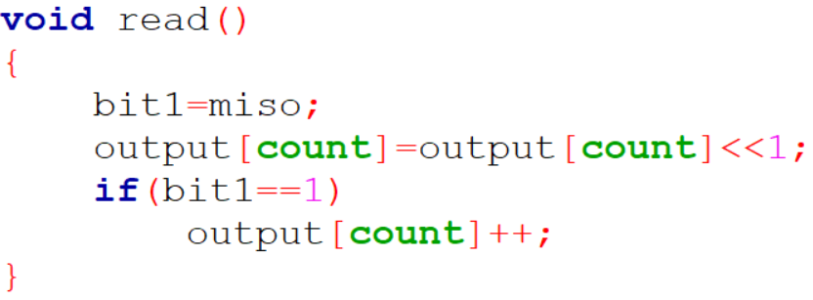
read()
00000000
00000000
output[count]<<1
00100000
00110000
…

Slide 19
Write Program Memory (Byte)
Instruction | Byte1 | Byte2 | Byte3 | Byte4
Write Memory (Byte Mode) | 0100 0000 | xxxx A[11:8] | A[7:0] | D[7:0]
Write data to Program memory in the byte mode
A[11:0] : 12-bit address, D[7:0] : 8-bit data
0010 0000
xxxx A[11:8]
A[7:0]
D[7:0]

Slide 20
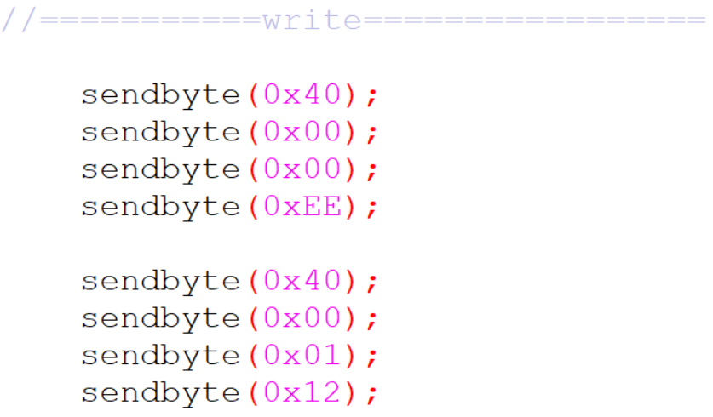
Write Program Memory
0010 0000
xxxx A11A10A9A8
A7A6A5A4A3A2A1A0
Write data 1110 1110 at address 0000 0000 0000
Write data 0001 0010 at address 0000 0000 0001

Slide 21

Persistence of Vision Clock (POV clock)

Slide 22
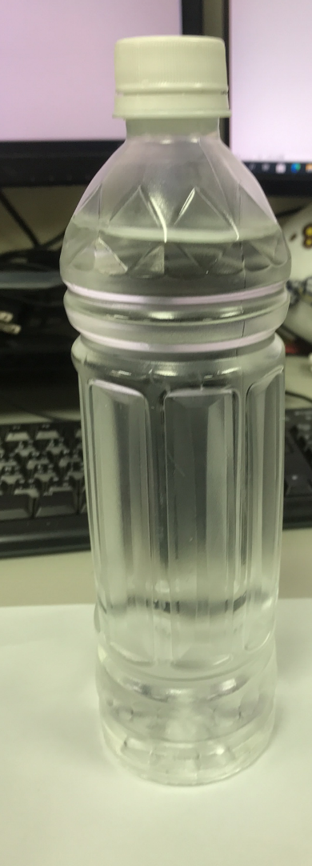
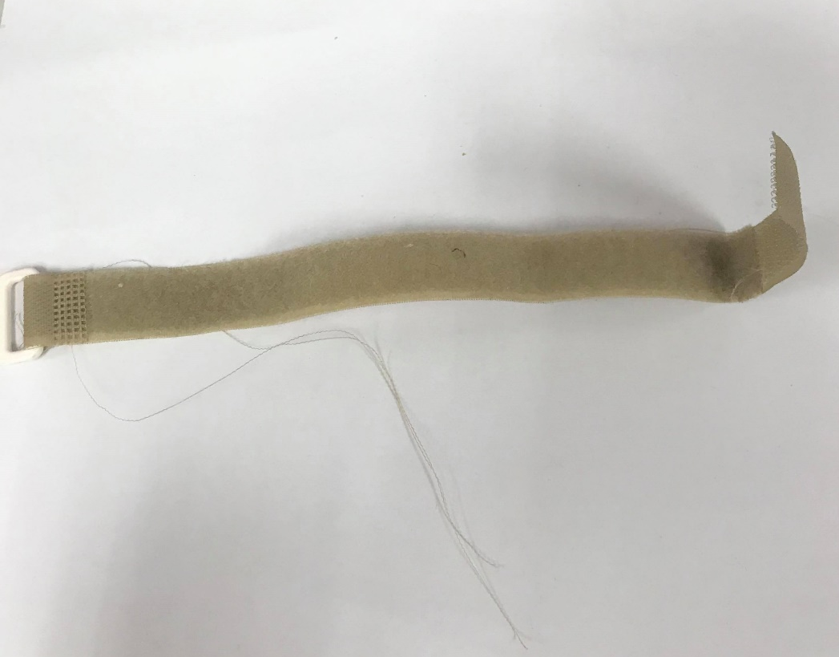
Required Components
Plastic Bottle
Velcro Strap

Slide 23
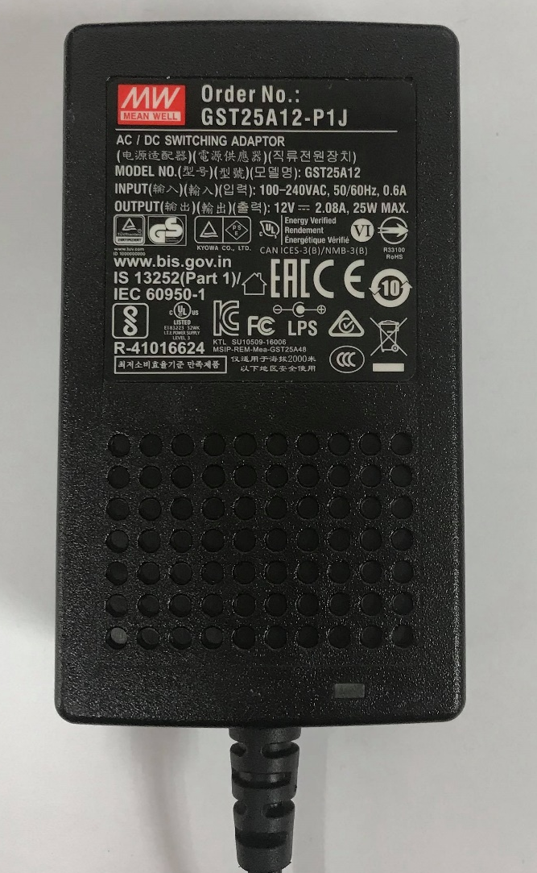
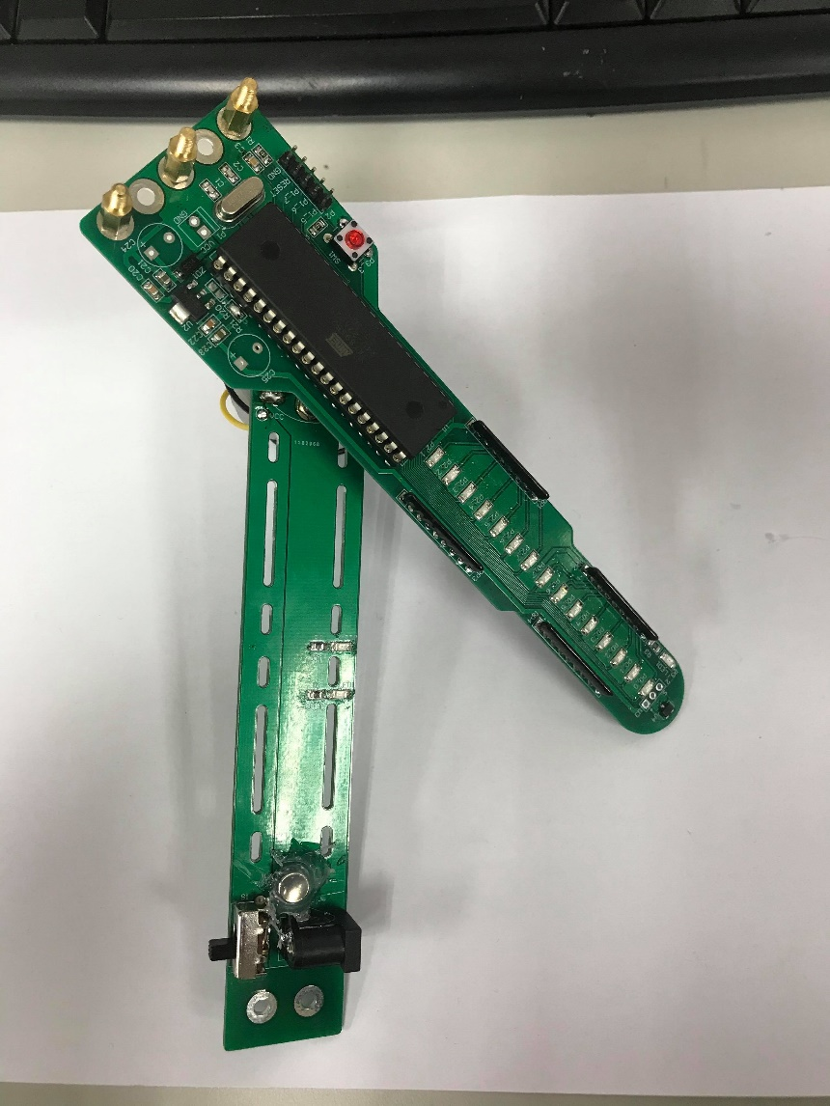
Required Components
AC/DC Switching Adaptor
POV Module prepared by TA

Slide 24
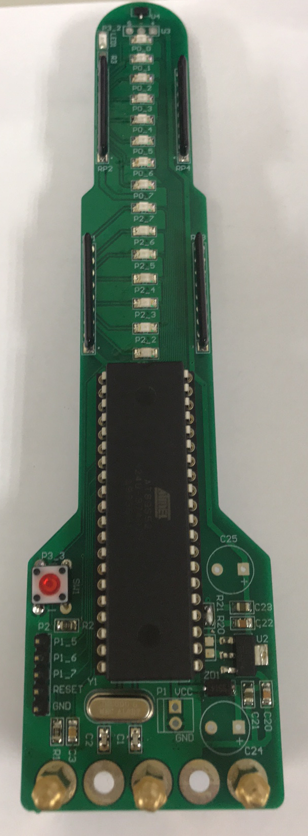
POV Clock Module
Microprocessor
AT89S52
Hall sensor
P3_2
15 LED on both sides
P0_0 ~ P0_7
P1_0 ~ P1_7
P2_0 ~ P2_7
P3_0 ~ P3_1
P3_4 ~ P3_7
P3_3 Button for user use
5 pins for programming
MOSI (P1_5)
MISO (P1_6)
SCK (P1_7)
RST
GND
32Mhz Crystal Clock

Slide 25
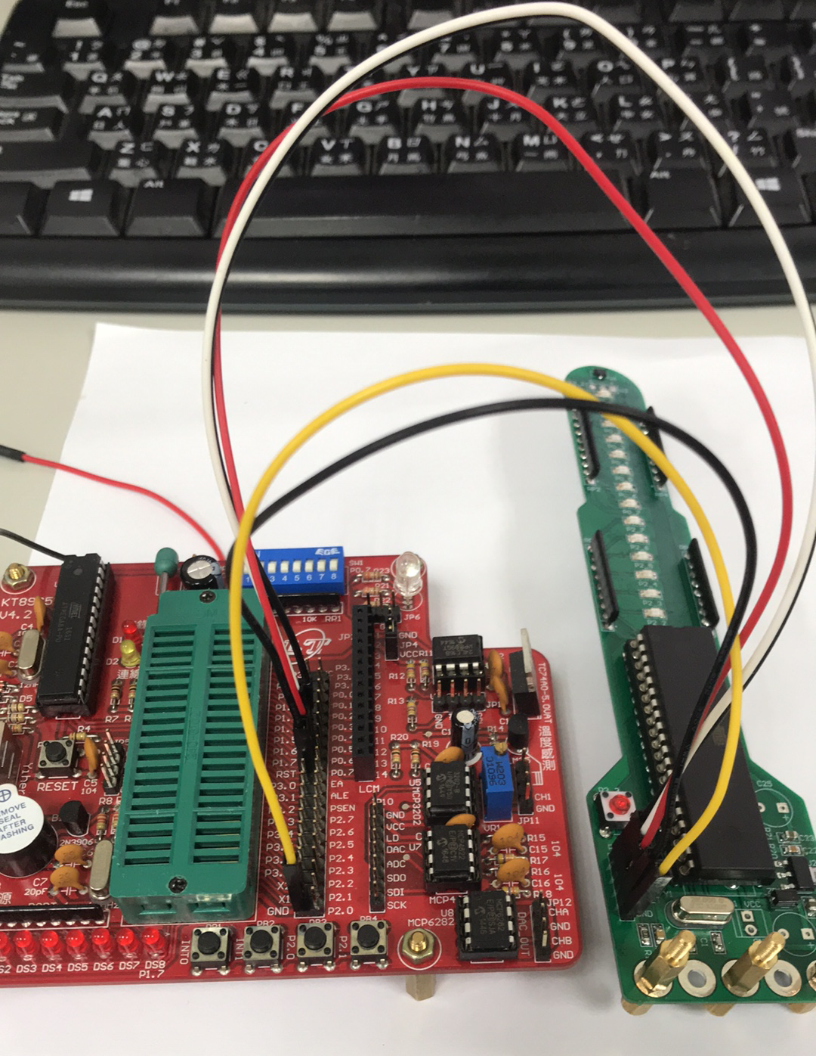
Programming code in POV module
Remove 8051 on the board first
Connect 5 pins to programming board
MOSI (P1_5)
MISO (P1_6)
SCK (P1_7)
RST
GND
Using 89S51燒錄軟體 to program code (same as before)

Slide 26
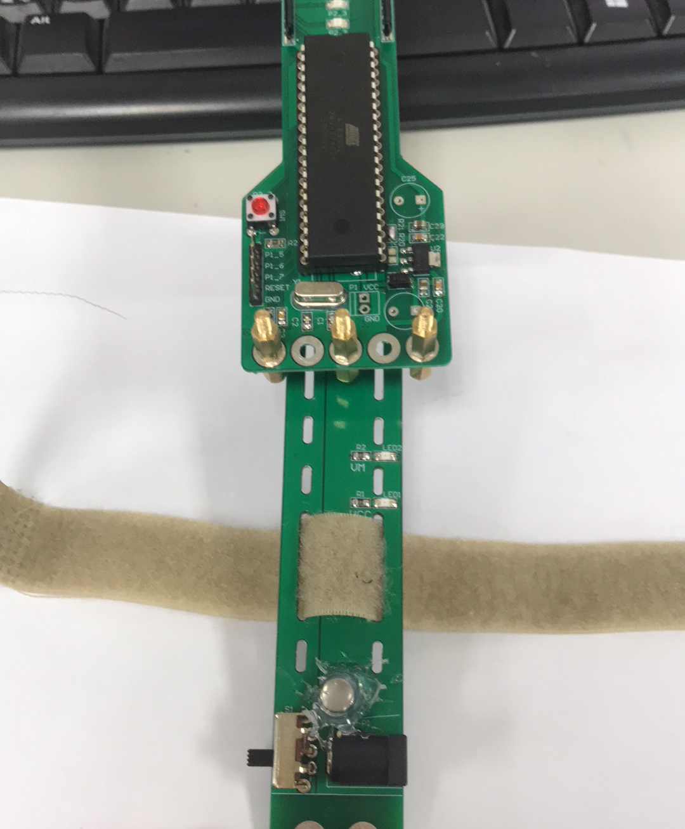
Assemble the Components
Step1: Fasten velcro strap on the POV module

Slide 27
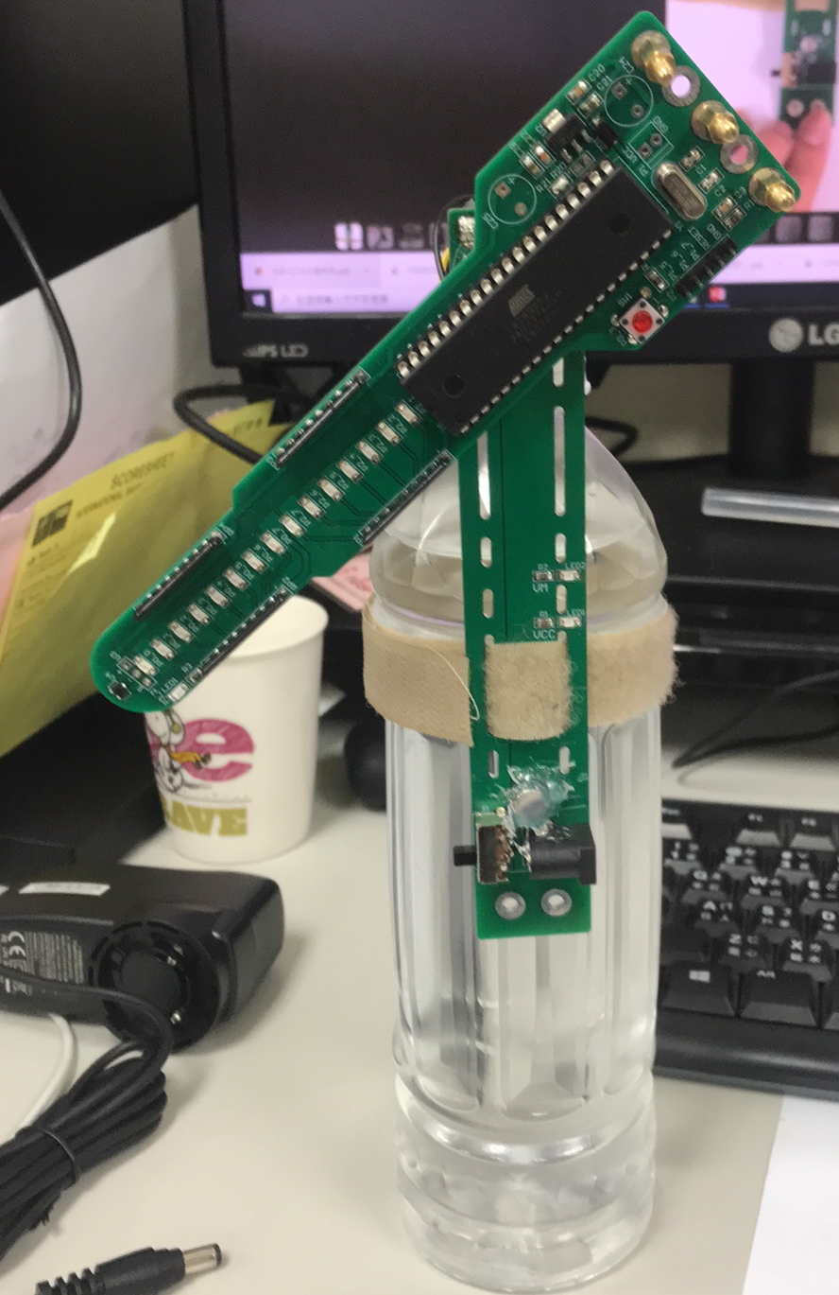
Assemble the Components
Step2 : Fasten the POV module on plastic bottle
Remember to fasten tightly for safety!

Slide 28
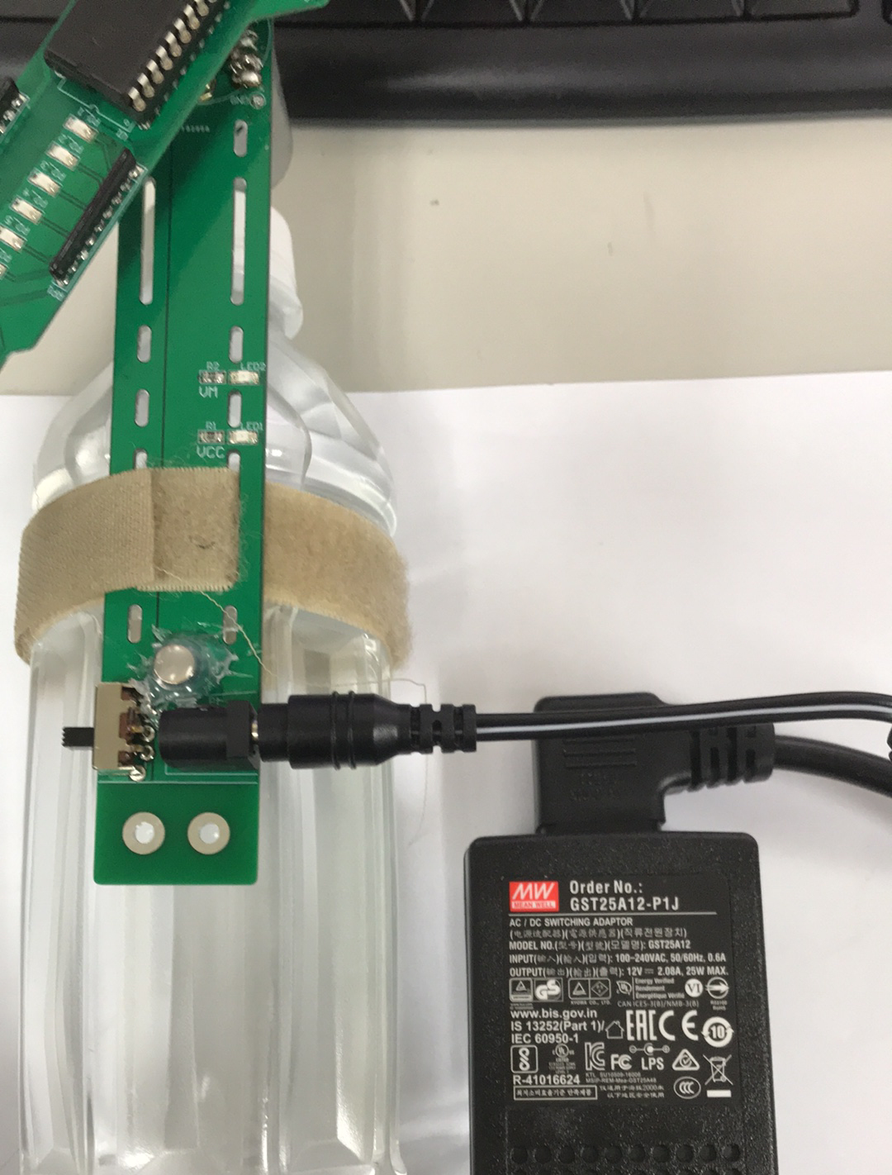
Assemble the Components
Step3: Connect power supply and POV module through switching adaptor

Slide 29
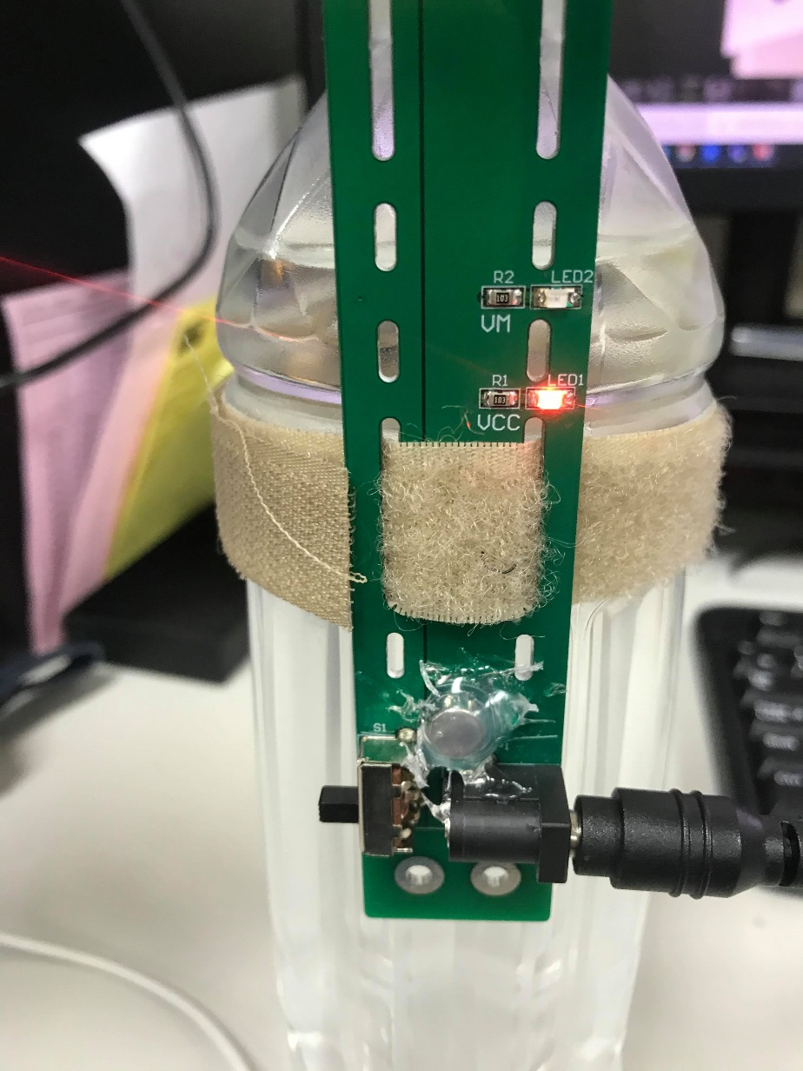
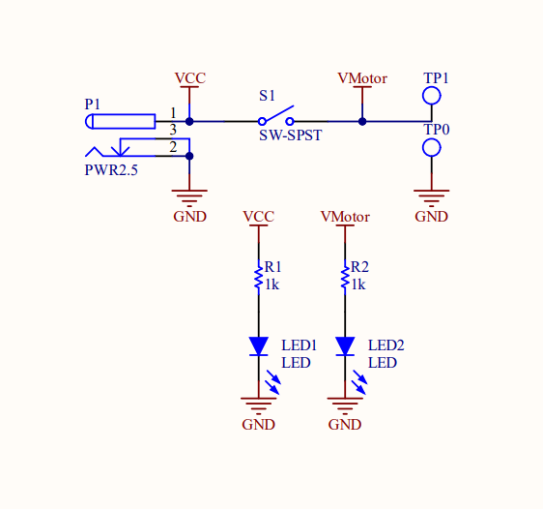
Alert LED
LED1 will light up if the module is powered up
Motor
29

Slide 30
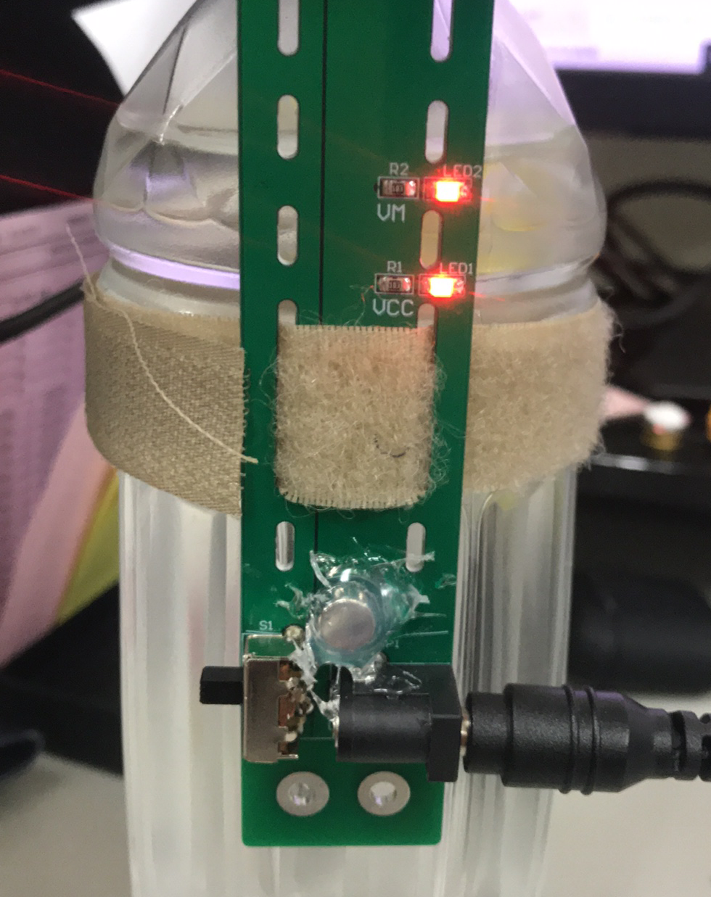
Alert LED
LED2 will light up if the motor switch is turned on
Be careful of your hands! The motor is turning now.

Slide 31
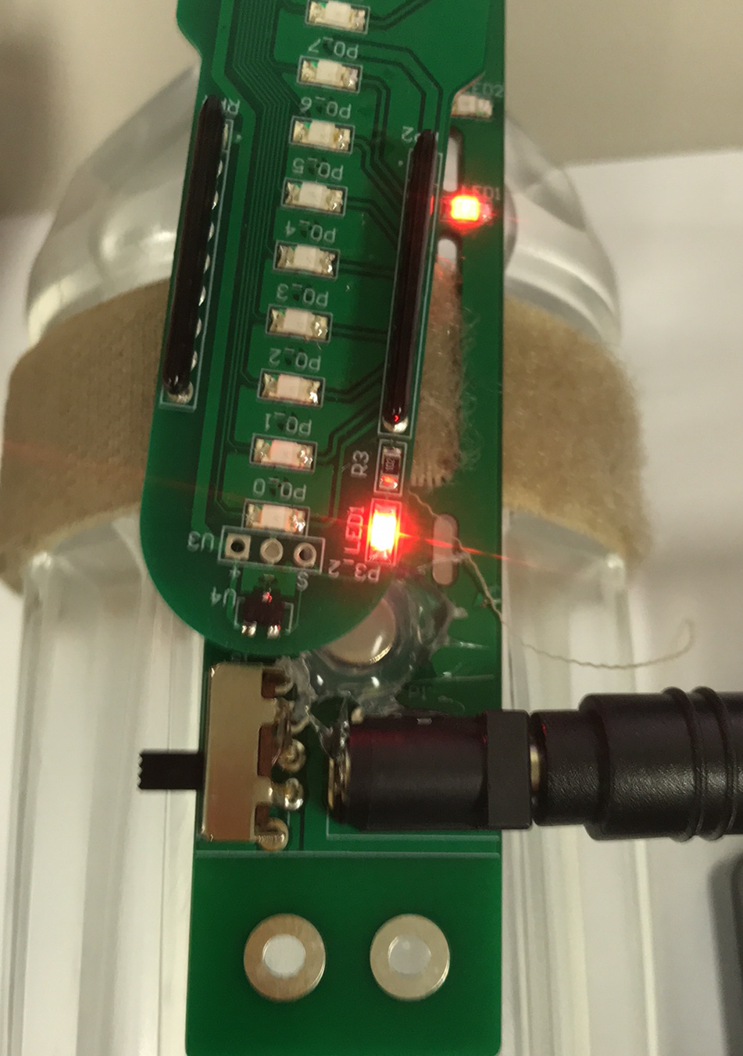
POV Clock
Using hall sensor to record the time per spin
LED1 will light up whenever the hall sensor pass through the magnet.

Slide 32


POV Clock
P3_2
the time per spin
the $n^{th}$ time pass through magnet
the ${(n+1)}^{th}$ time pass through magnet
Using timer to record time between 2 passes.
Determine the position where you want the led light up by calculating the timing.

Slide 33
Reference
https://www.keil.com/dd/docs/datashts/atmel/at89s51_ds.pdf
https://www.keil.com/dd/docs/datashts/atmel/at89s52_ds.pdf
https://www.engineersgarage.com/tutorials/89s51-52-isp-programmer-basics/

